Slide 1
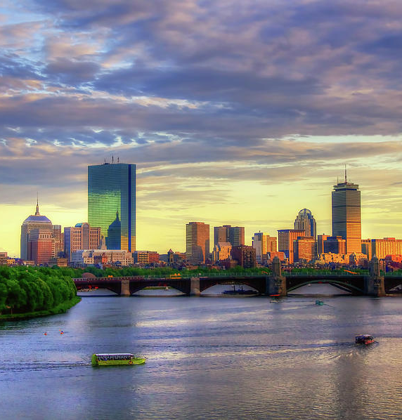
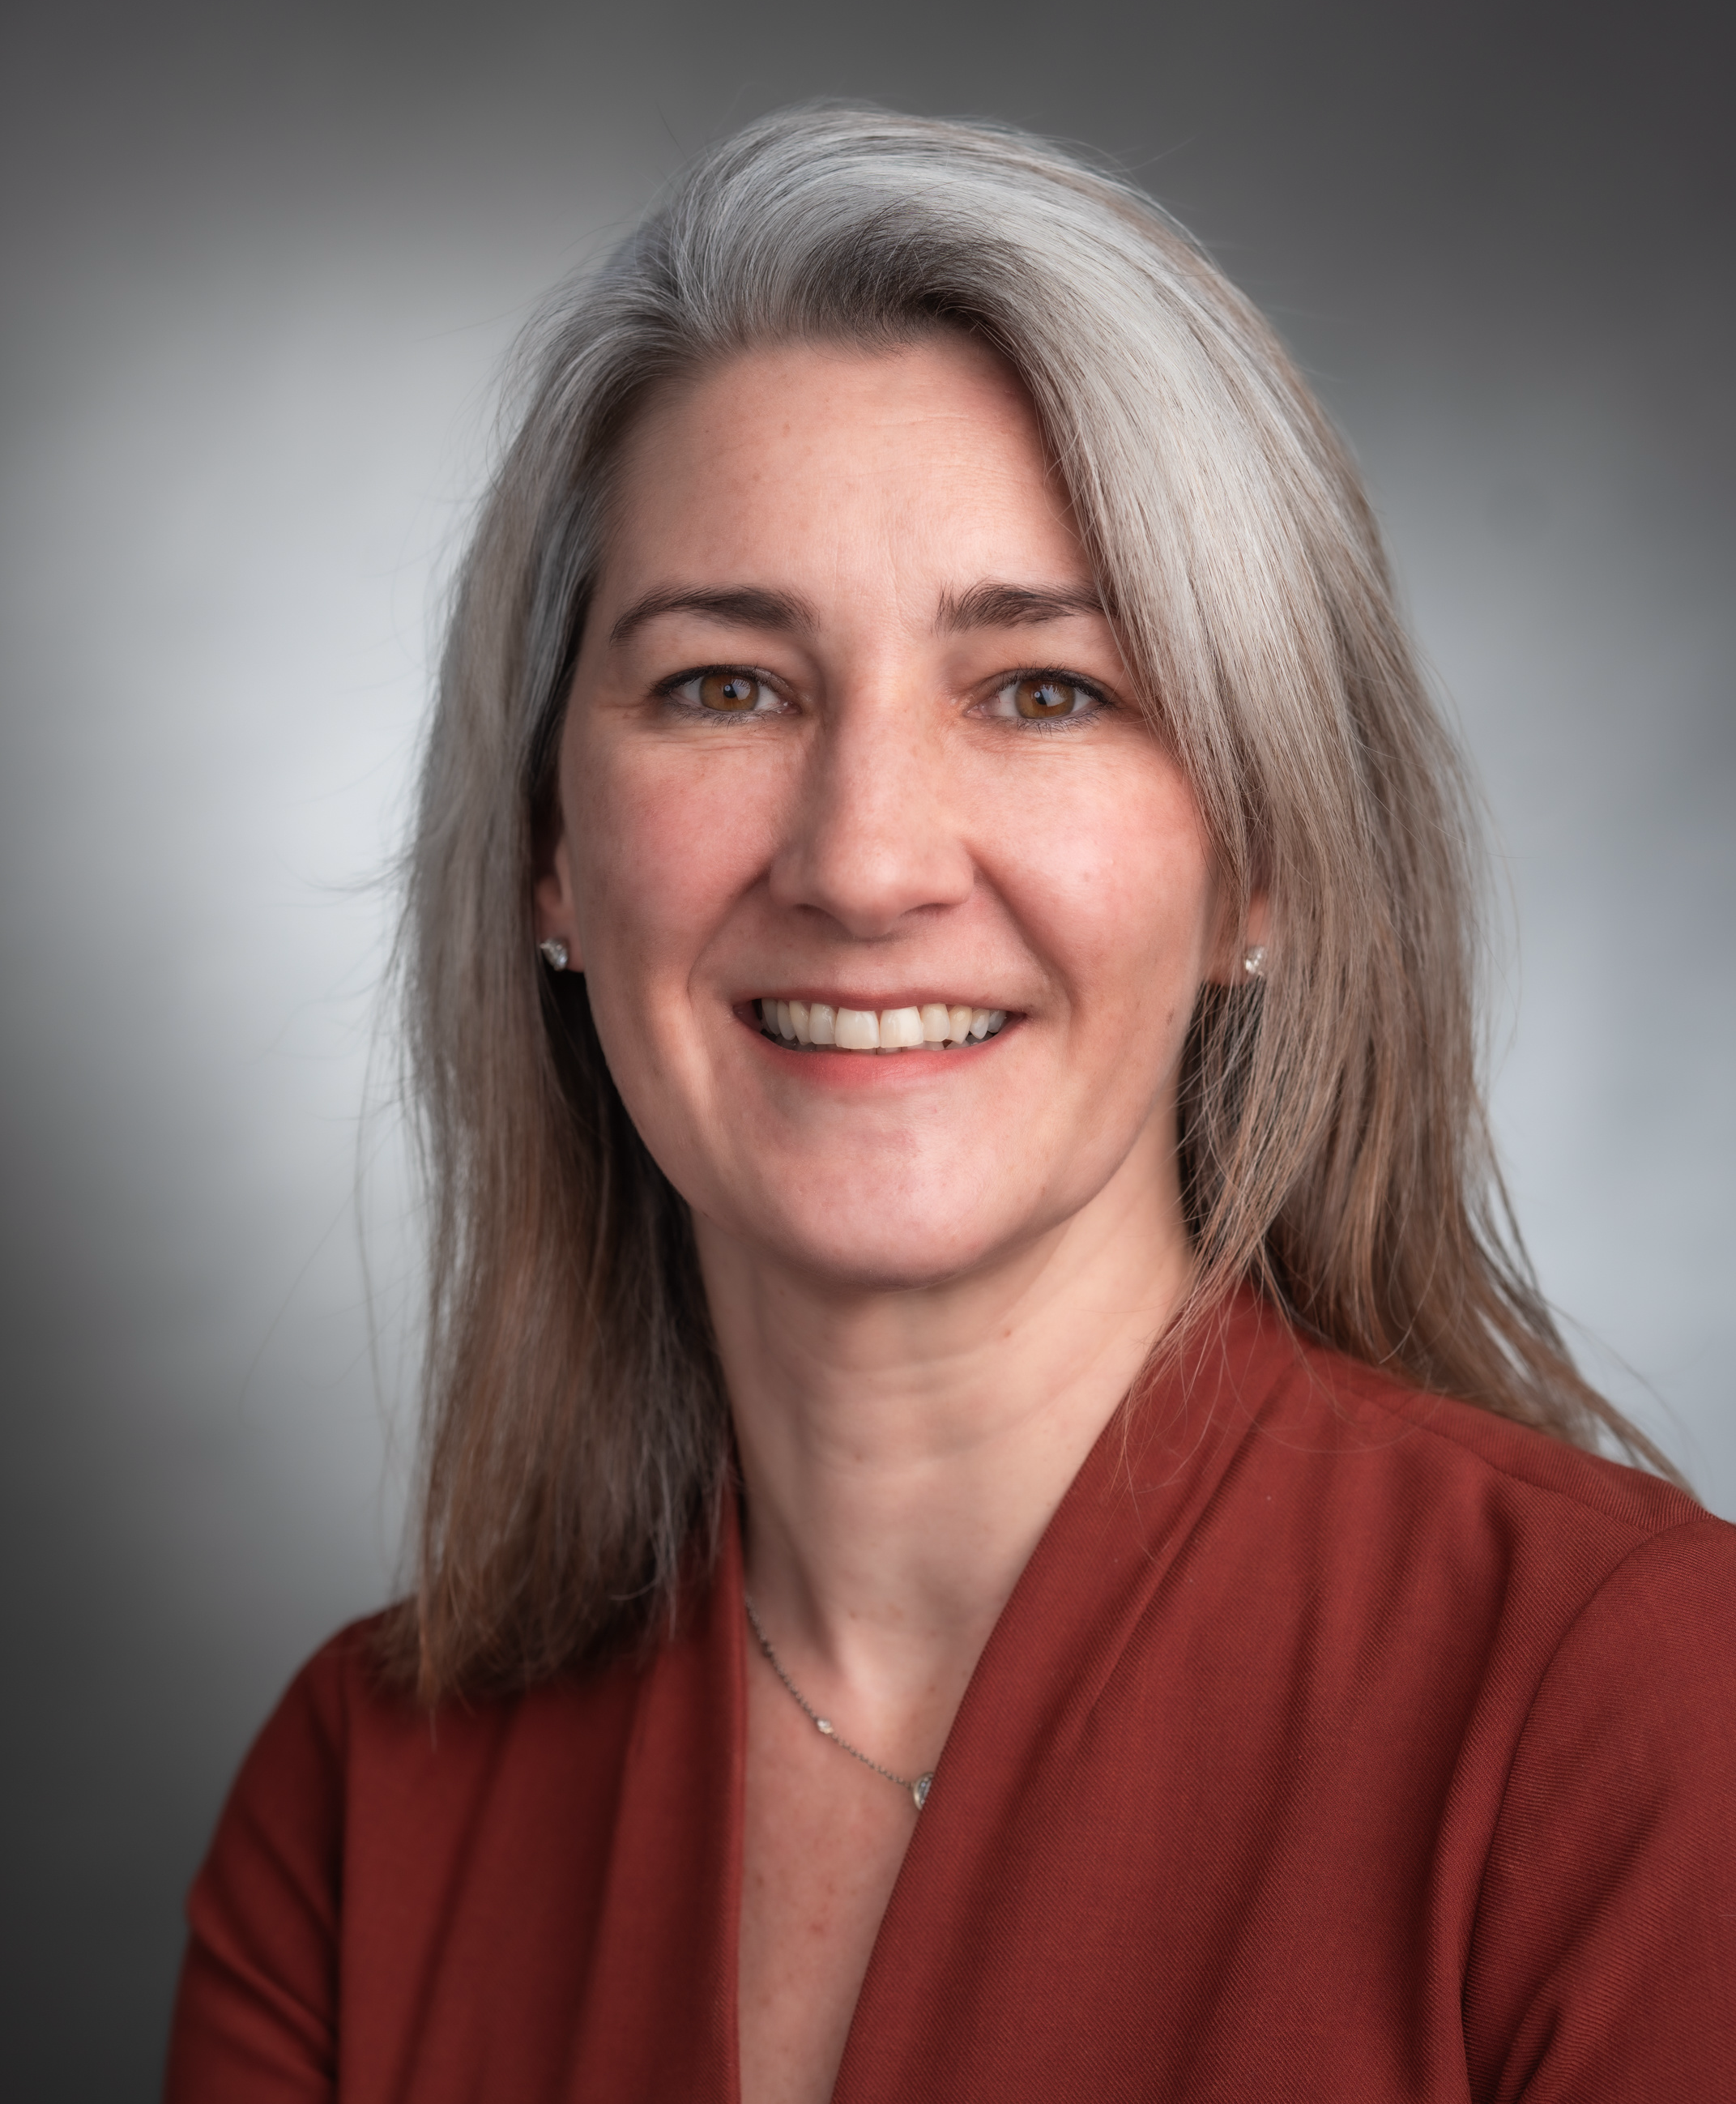
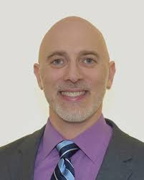
THE 4TH INTERNATIONAL MCC SYMPOSIUM
SAVE THE DATE
April 27-28, 2026
Boston, MA, USA
#mcc4
Annie Silk
Dana-Farber
Isaac Brownell
NIH/NIAMS

